Slide 1
Net Open Finder
Group 6
李瓖芸、周昀、吳宜凡

Slide 2
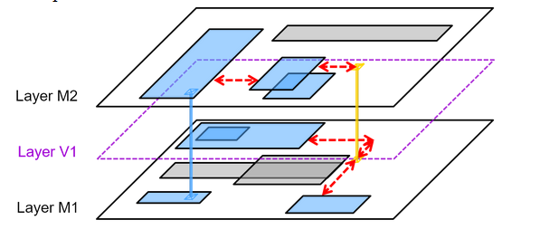
Goal
Connect all Shapes and Vias into one set with the minimum cost of the connections.

Slide 3
Main problems
* Finding shortest path for two distinguish points with or without obstacles between.
* Check for disjoint sets.
* Determine the closest point pair between two disjoint set.
* Avoid duplicated connection.
* Simplify the three-dimensional problem.

Slide 4
Others’ solution

Slide 5
Our solution
For each layer, sort all the shapes on x/y direction and check for all the overlapping, thus find all the trivial connections.

Slide 6
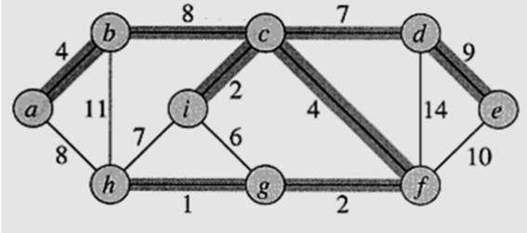
Our solution
Build a graph with nodes representing all the shapes and edges representing all the trvial connections. Then build a minimum spanning tree to find the necessary edges.

Slide 7
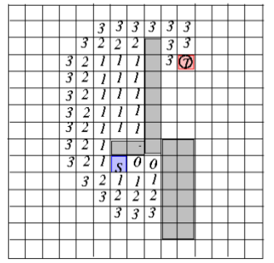
Our solution
For the remained disjoint set, use Hadlock’s Algorithm to find the shortest path for the chosen point pairs.

Slide 8
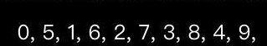
Our solution
Use OpenMP library to perform parallel for loop. This method is effective for this problem can be easily parellized.

Slide 9
Complexity
N: number of shapes on each layer
O: number of obstacles
E: number of edges (all trivial connection) (usually an order larger than the number of nodes)
X,Y: distance between two points

Slide 10
Complexity
Trivial connection scanning: O(N^2)
Minimum spanning tree: O(E lgE)
Line adding: Θ(O)
Hadlock’s shortest path: Θ(X*Y)

Slide 11
Improvement

Slide 12
Result
Benchmark/case1
#Shape=1503, #Obstacle=414
Layer1: E=7300, V=550, one MST
Layer2: E=2723, V=241, one MST
Layer3: E=9951, V=712, one MST
#Shape not in Graph=0
Benchmark/case2
#Shape=4518, #Obstacle=4773
Layer1: E=10589, V=767, one MST
Layer2: E=11082, V=929, one MST
Layer3: E=11831, V=917, one MST
Layer4: E=12693, V=1019, one MST
Layer5: E=11122, V=875, one MST
#Shape not in Graph=11

Slide 13
Discussion

